Slide 1

Exploratory Data Analysis
By Ahmad farichin
Data Science | Digital SkillFair 39

Slide 2
Analyzing Netflix Titles Dataset: Uncovering Trends and Insights
01
02
03
04
05
Introduction
Data Cleaning
Descriptive Analysis
Visualization
Conclusion & Insights

Slide 3
INTRODUCTION
Background Netflix has grown into a global streaming giant, offering a vast library of content that spans across genres, languages, and countries. To better understand what Netflix offers and how its content is structured, we analyzed a dataset containing information about its movies and TV shows.
Purpose of the Analysis
To explore the structure and characteristics of the Netflix titles dataset
To identify content trends, distribution, and common patterns
To detect missing values and outliers for data quality assessment
To extract insights that can help inform content strategy or user recommendations

Slide 4
Dataset Overview
Feature | Description
show_id | Unique identifier for each title
type | Type of content: Movie or TV Show
title | Title of the content
director | Name of the director (can be missing)
cast | Main actors or actresses involved (can be missing)
country | Country where the content was produced (can be missing)
date_added | Date when the title was added to Netflix
release_year | Year the content was originally released
rating | Content rating (e.g., TV-MA, PG-13)
duration | Length of the content (in minutes for Movies, seasons for TV Shows)
listed_in | Categories or genres assigned to the title
description | Short summary or synopsis of the title

Slide 5
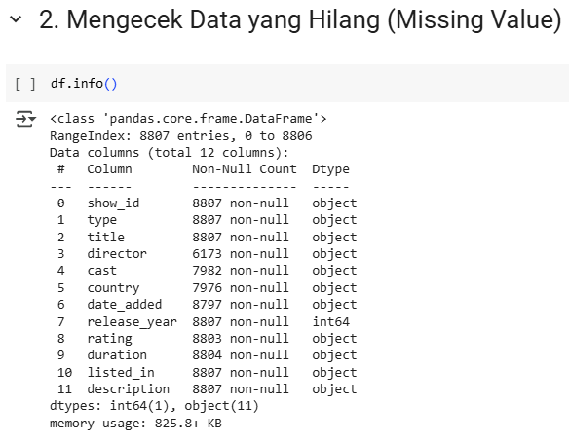
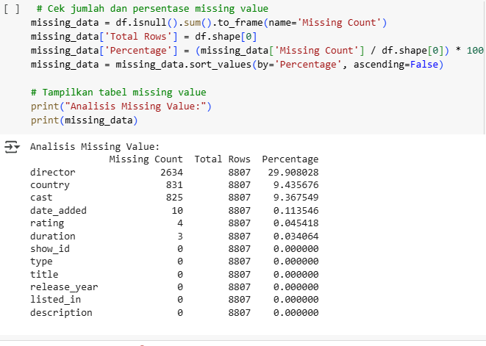
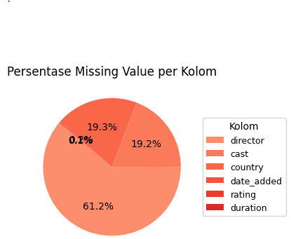
Data cleaning
From the information we get from the data, there is some missing data on director, cast, country, date_added, rating, duration.

Slide 6
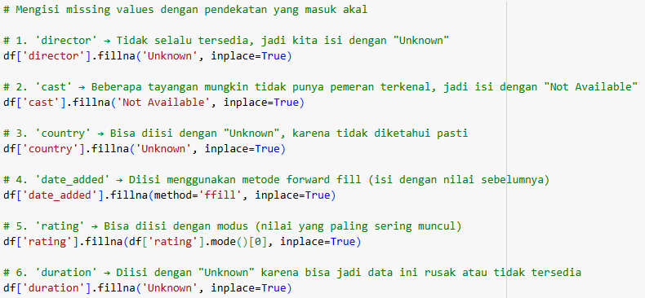
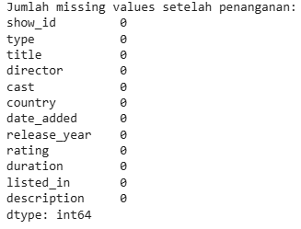
fill in the empty missing values

Slide 7
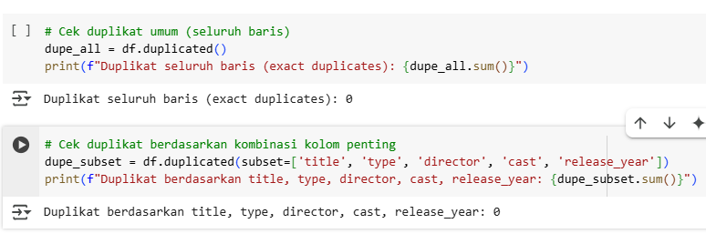
Handling Duplicate
After checking duplicate handling, no duplicate data was found.

Slide 8
Deskriptif analysis
Basic Statistics :
1.Total Titles: 8,807
2.Movies: 6,134 (~70%)
3.TV Shows: 2,673 (~30%)
4.Average Release Year: 2013
5.Oldest Title: 1925
6.Most Common Release
Year:2018
Top 5 Countries Producing: 1.Content
2.United States
3.India
4.United Kingdom
5.Canada
6.Japan
Duration Insights :
1.Movies: Most commonly
around 90–100 minutes
2.TV Shows: Typically have
1–2 seasons
Most Common Genres :
1.International Movies
2.Dramas
3.Comedies
4.Action & Adventure
5.Documentaries

Slide 9
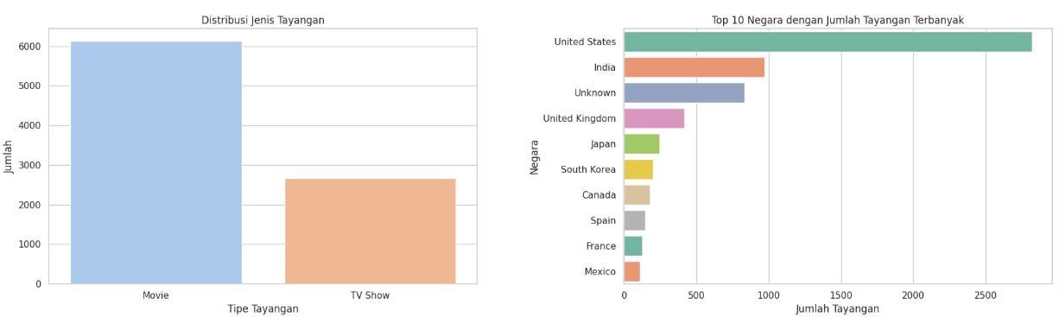
Visualization

Slide 10
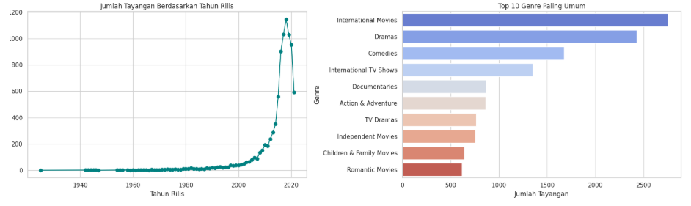
Visualization

Slide 11
Conclusion
Insights from the Visualization:
1. Movies dominate Netflix content compared to TV Shows.
2.The United States, India, and the United Kingdom are the
top contributing countries for Netflix content.
3.Netflix content experienced a significant surge between
2015 and 2020.
4. Popular genres include Dramas, International Movies, and
Comedies.

Slide 12
Thank You

